Slide 1
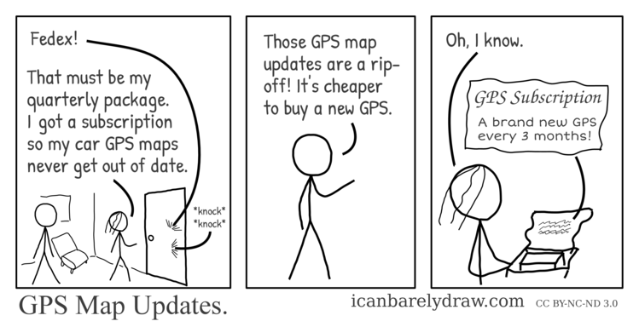
Differential map updates for highly automated driving and enhanced driver assistance services
http://www.icanbarelydraw.com/comic/comics/2013-07-29-gps-map-updates.png

Slide 2
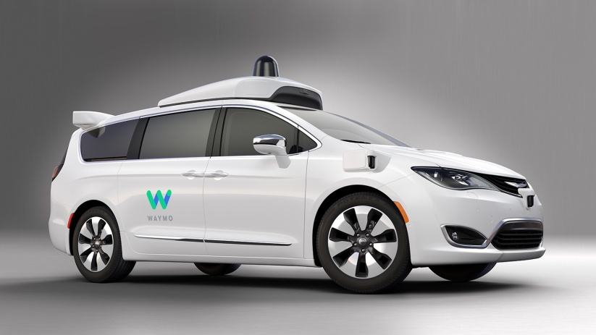

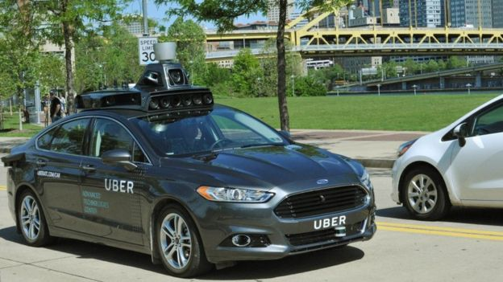
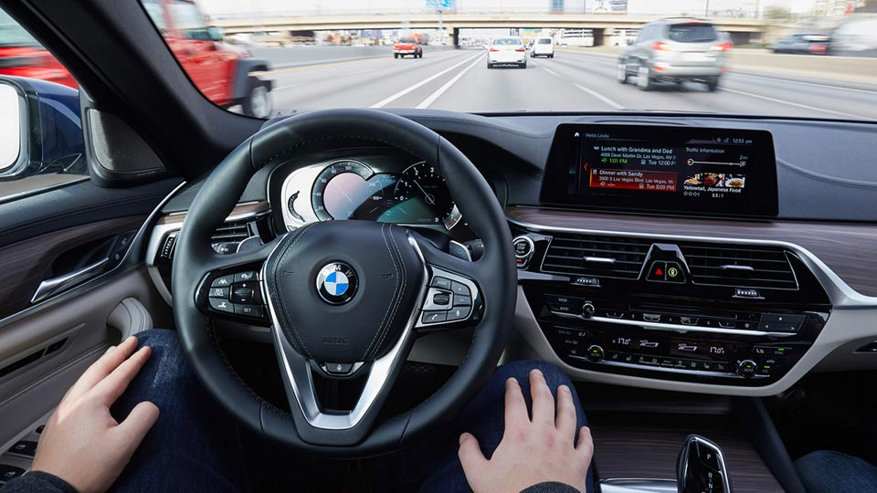
Motivation
Autonomous vehicles are coming...
http://cdn.autoindustriya.com/images/posts/post10150_2.jpg
http://ichef.bbci.co.uk/news/624/cpsprodpb/9B5E/production/_89747793_uatc-car-bridge-16x9-917x516.jpg
https://fortunedotcom.files.wordpress.com/2016/12/google-waymo-fca.jpeg

Slide 3
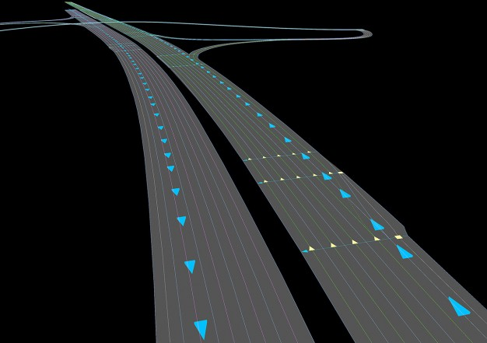
But...
Sensors based visibility limited to ~200m
High speeds not feasible*
In the 5th meeting of the Open Auto Drive Forum (14-Oct-2016)
The keynote speech
"Addressing the challenges of HD maps and Autonomous Driving“
In the 6th meeting (16-Feb-2017), High Definition maps was one of the main focus areas
http://www.openautodrive.org/news_5th_Meeting.php http://www.openautodrive.org/news_6th_Meeting.php
http://www.openautodrive.org/resources/images/openADForum.jpg
* except in Controlled environments
http://blog.caranddriver.com/wp-content/uploads/2016/05/Map-Quest-inline-626x441.jpg

Slide 4
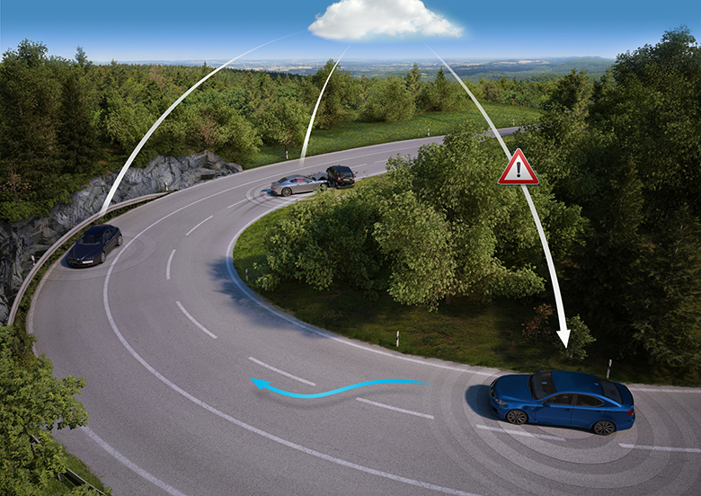
More Updates
Cars acting as sensor nodes
https://cdn-360-content.s3.amazonaws.com/uploads/2015/06/LiveRoads.png

Slide 5
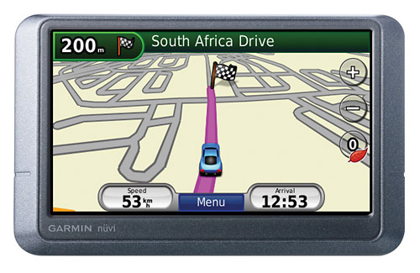
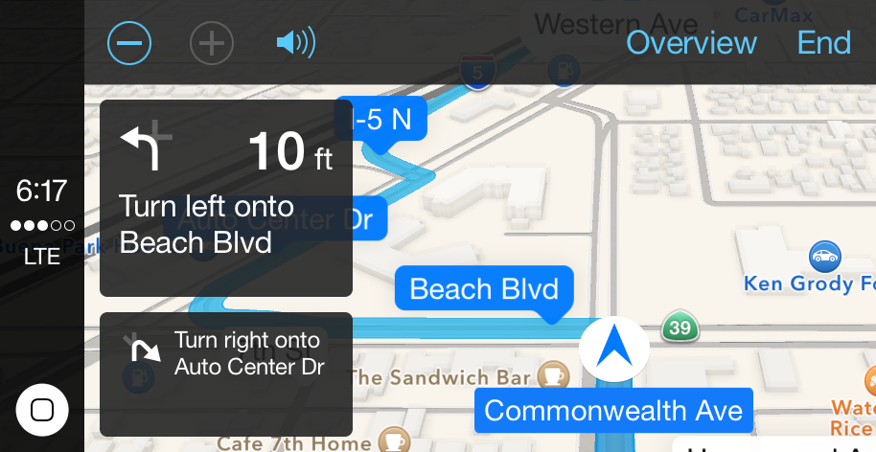
Existing Car Navigation Map Solutions
http://cars.typepad.com/.a/6a00d83451b3c669e20147e1c04c16970b-pi
https://sites.google.com/a/cypanthers.org/cyhsdrivered/_/rsrc/1391891997284/how-to-use-and-install-a-gps-correctly/garmin.png
https://cnet2.cbsistatic.com/img/9LAJgcpc_an8dRfX5ecP913S9b4=/770x433/2015/10/19/46d396fc-32eb-4b5c-8805-3a4ffa1e2695/carplay-1.jpg
https://www.androidcentral.com/sites/androidcentral.com/files/articleimage/Casey%20Chan/2009/10/nav-gallery-18.jpg
Offline
Online
http://e84.xbimmers.com/forums/showthread.php?p=14027294
https://svbtleusercontent.com/bv8igbik8skqcg.png

Slide 6
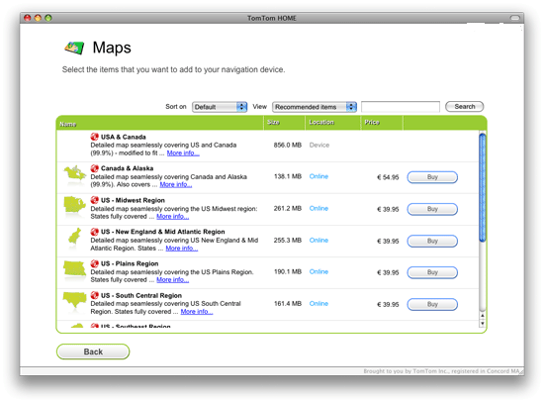
Disadvantages
Binary format
Large downloads
Time consuming (sometimes ~2 hr*)
Unnecessary updates
Frequency of updates
* https://auto-update.garmin.com/auto-update/?lang=en_US

Slide 7
Outline
Motivation
Related Work
The Approach
Results
Conclusion

Slide 8
Enabling Partial Update
Connection Maintained – Locally Differential Map Update [Asahara et al. 2008]
Map Air Update Server [Min et al. 2011]
Region | Inserts | Delete | Updated | Total
Spain | 14% | 6% | 10% | 30%
Luxembourg | 5% | 4% | 6% | 15%

Slide 9
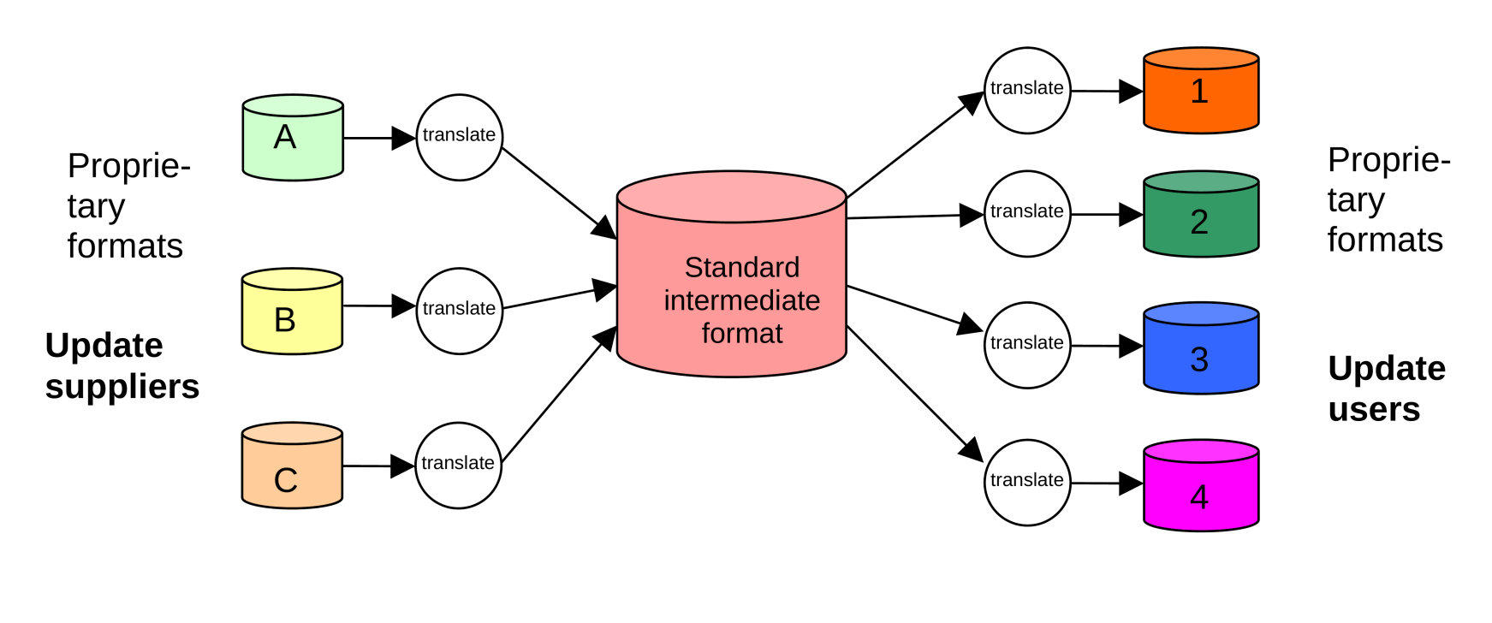
The ActMAP project
Real-time map updates [Bastiaensen et al. 2003]

Slide 10
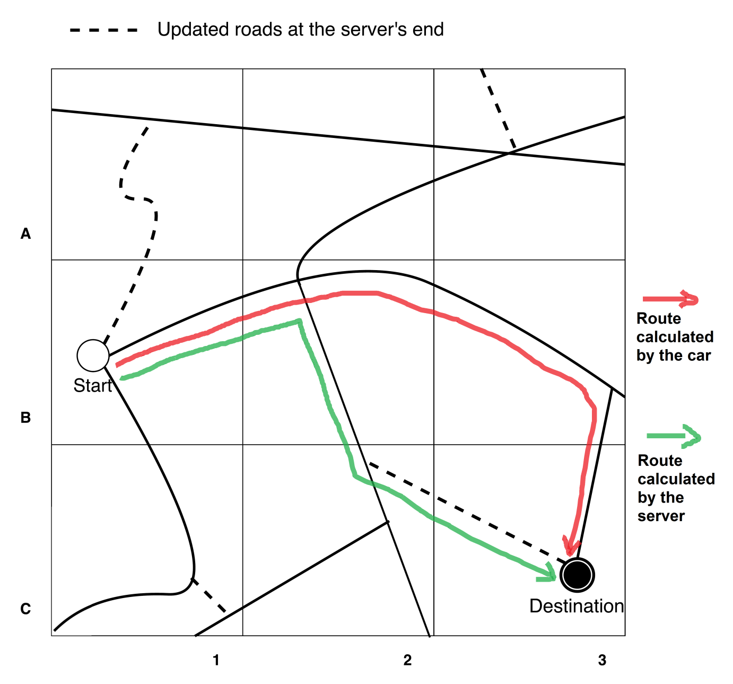
A portion of the Map

Slide 11
Map Updates
Grids with changes
Newly added roads

Slide 12
The Car's calculated Route
Grids traversed in the car‘s route
Newly added roads

Slide 13
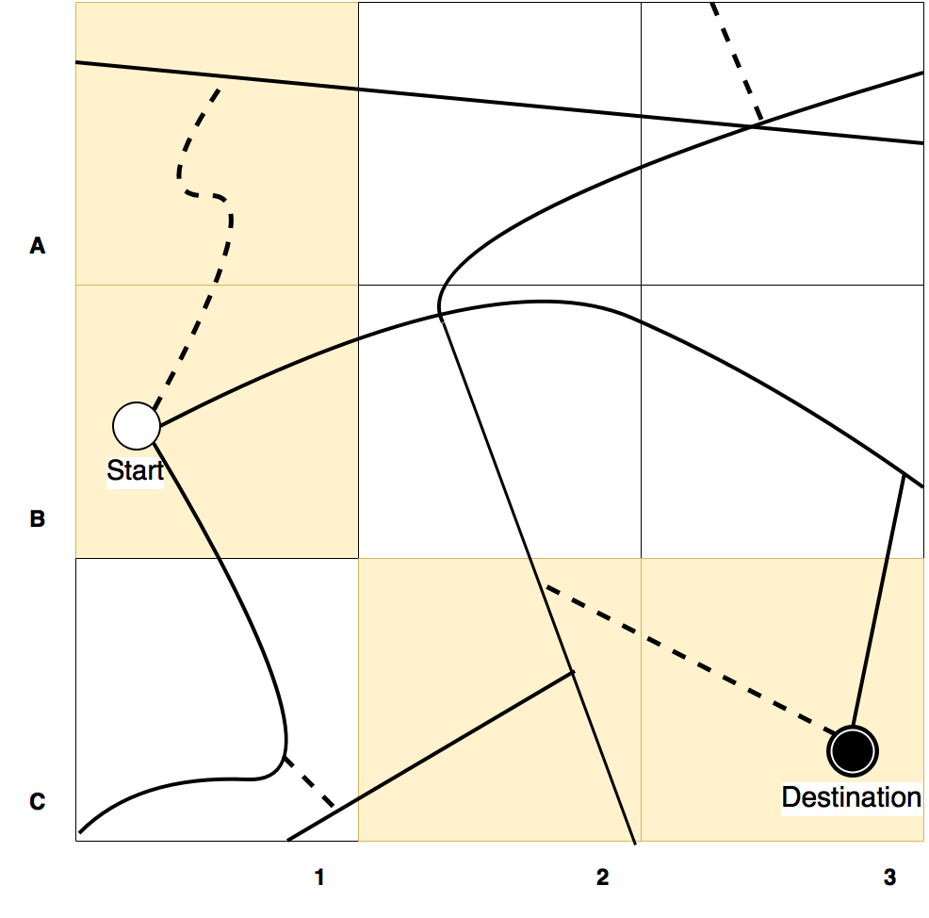
Simple Map Update Protocol*
Grids updated
Newly added roads
Update as you drive
A1 & C2 extra for Consistency
* Bastiaensen, Edwin. "ActMAP: real-time map updates for advanced in-vehicle applications." Proceedings, 10th World Congress on ITS, Madrid. 2003.

Slide 14
Inefficiencies
No consideration of contextual information
Extra updates

Slide 15
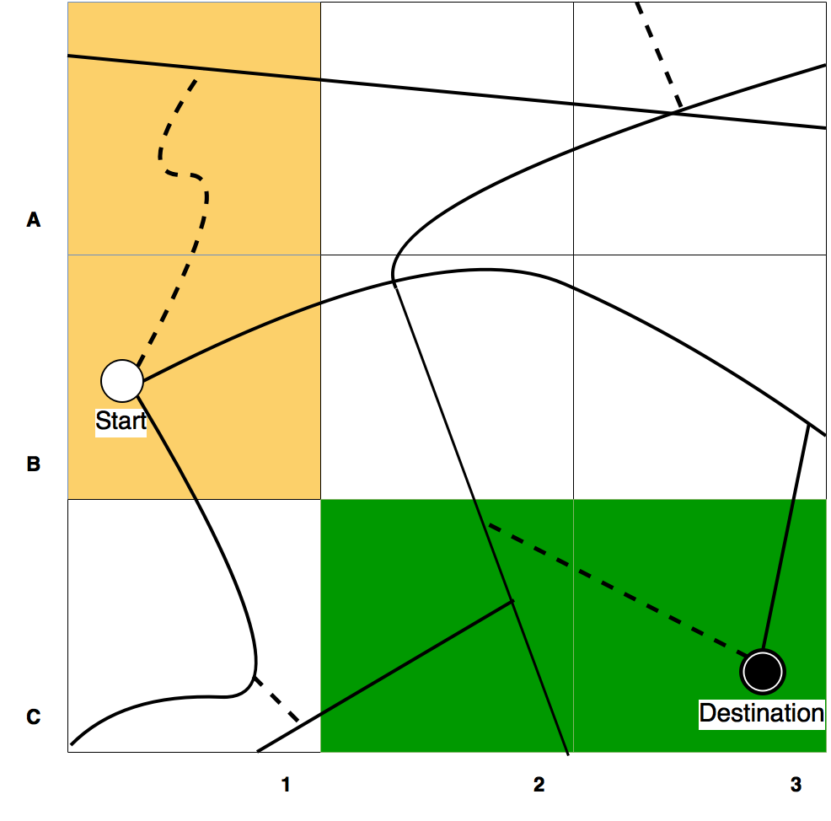
Relevance
Mandatory Grids
Optional Grids

Slide 16
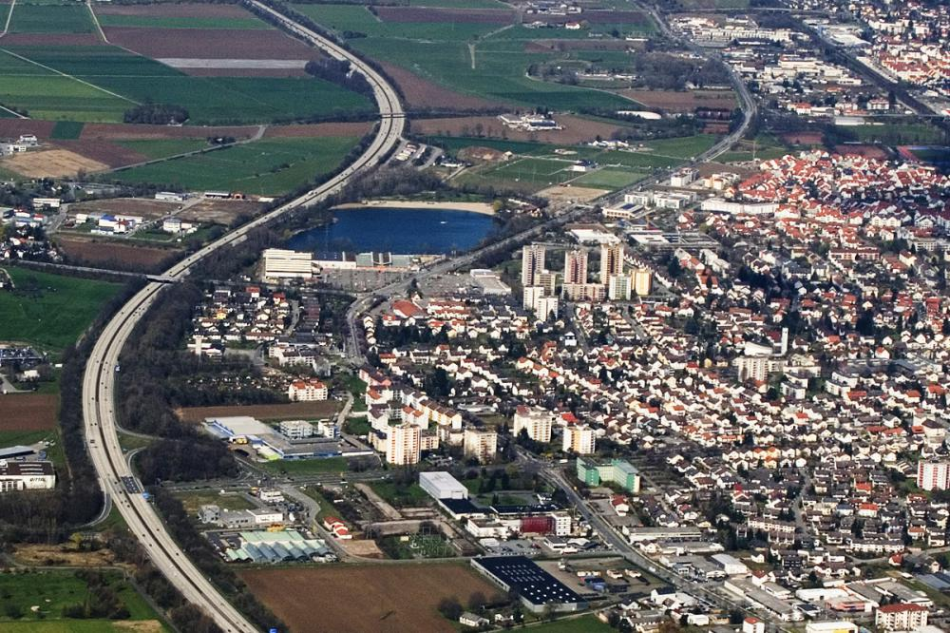
Driving on a highway!
http://www.wirtschaftsregion-bergstrasse.de/var/wrb/storage/images/media/bibliothek/bilder/bildarchiv-wirtschaft-arbeit-energie/wirtschaft/autobahn-a5-bensheim-luftbild/10109-1-ger-DE/Autobahn-A5-Bensheim-Luftbild_front_large.jpg

Slide 17

Other Examples
Public transport vehicles
Based on pollution levels
Different routing requirements
http://gadgets.ndtv.com/transportation/features/how-ups-trucks-saved-million-of-dollars-by-eliminating-left-turns-1657808

Slide 18
Outline
Motivation
State of the art
The Approach
Results
Conclusion

Slide 19
Assumptions
Car has version 1 (v1)
Server has version 2 (v2)

Slide 20
Car -> Server
(Start, Destination, Map Tiles & Versions, Hash of route)
{Start, Destination, {B1:v1, 1:v1, 1:v1, 0:v1}, 32CB}
6
2
5
3
1
7
0
4

Slide 21
Server -> Car
(Hash of route, Map tiles used & version, Updates for map tiles)
{39AF, {B1:v2, 1:v1, 0:v2, 1:v2}, 32CB}
+ Map Updates for C2 & C3
6
2
5
3
1
7
0
4

Slide 22
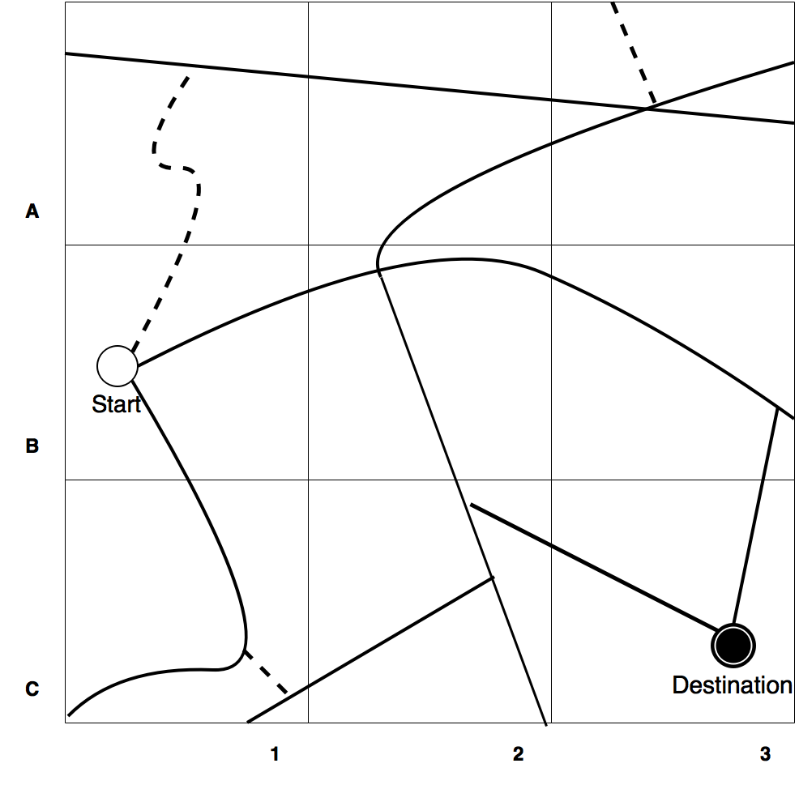
Car -> Server (Repeat till Hash Matches)

Slide 23
Outline
Motivation
State of the art
The Approach
Evaluation
Conclusion

Slide 24
Why OpenStreetMap?
High Definition Maps
OpenDrive
Open Lane Model
Navigation Data Standard
OpenStreetMap
Volunteered Geographic Information
For Germany, 27%* more than Commercial offerings
*Neis, Pascal, Dennis Zielstra, and Alexander Zipf. "The street network evolution of crowdsourced maps: OpenStreetMap in Germany 2007–2011." Future Internet 4.1 (2011): 1-21.

Slide 25
Evaluation
Duration between old & new version (31/08/2016)
2+ Years (01/01/2014)
1+ Year (01/01/2015)
45 days (16/07/2016)
30 days (01/08/2016)
15 days (16/08/2016)
1 day (30/08/2016)
10,000 trips (Pasaoglu et al.)
20% > 30 km
60 % between 10 and 30 km
20 % < 10 km
For Larger Areas
20 % > 50 km
60 % between 15 & 50 km
20 % < 15 km
Pasaoglu, G., et al. "Driving and parking patterns of European car drivers-a mobility survey." Luxembourg: European Commission Joint Research Centre (2012).

Slide 26
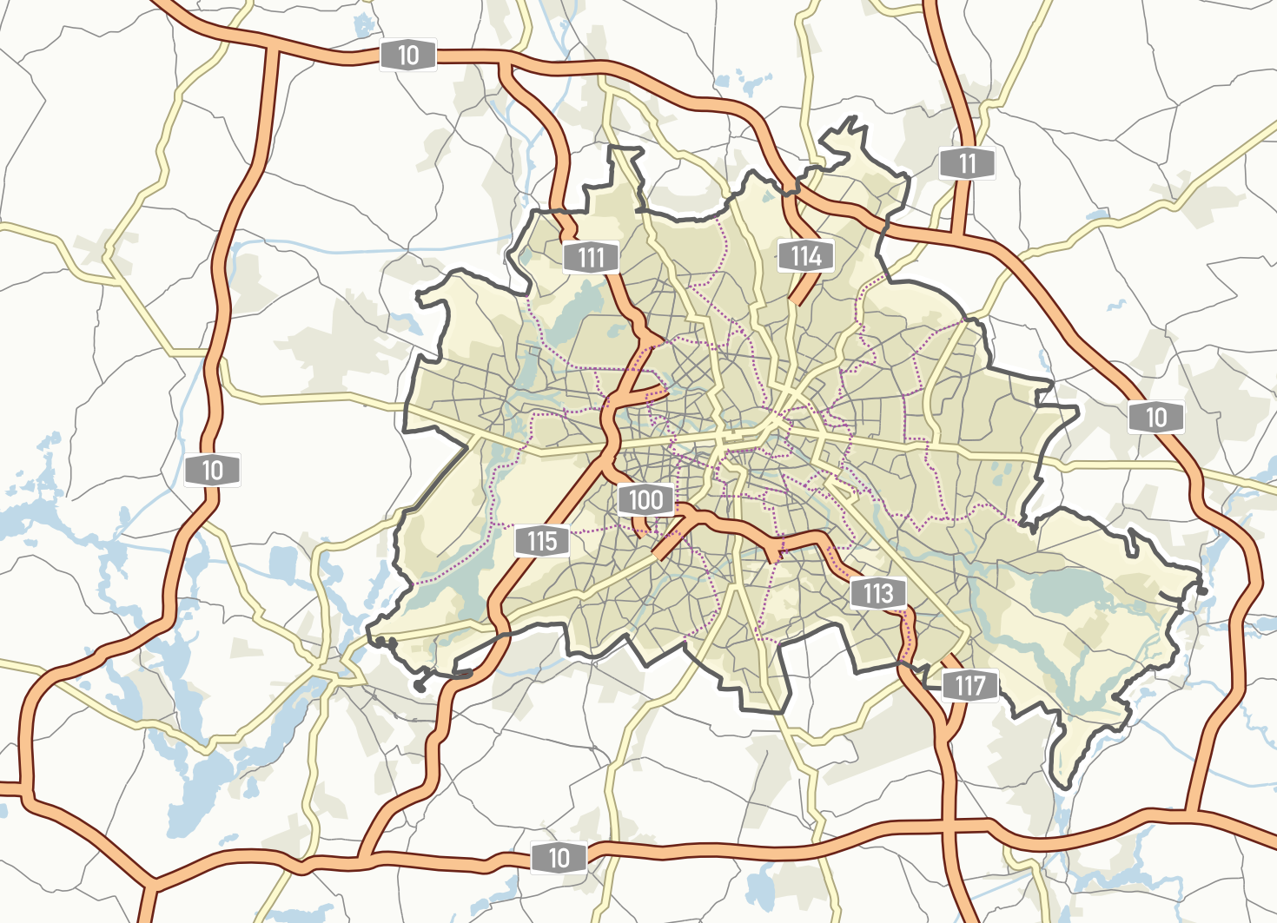

Scenario 1: One trip per car, 10,000 such cars
Calculates savings on server’s end
https://upload.wikimedia.org/wikipedia/commons/0/01/Berlin_Stra%C3%9Fenverkehr_%C3%9Cbersichtskarte.png

Slide 27
Evaluation Result

Slide 28


Scenario 2: 10 trips per car, 1000 such cars
Calculates savings on client’s end
https://upload.wikimedia.org/wikipedia/commons/0/01/Berlin_Stra%C3%9Fenverkehr_%C3%9Cbersichtskarte.png
https://cdn1.iconfinder.com/data/icons/transportation-vehicles-2/128/self-driving-car-g-radar-128.png

Slide 29
Evaluation Period
August 2016
30 x 1-day Differences
01/08/2016 – 02/08/2016
02/08/2016 – 03/08/2016
…
30/08/2016 – 31/08/2016
16 x 15-days Differences
01/08/2016 – 16/08/2016
02/08/2016 – 17/08/2016
…
16/08/2016 – 31/08/2016

Slide 30
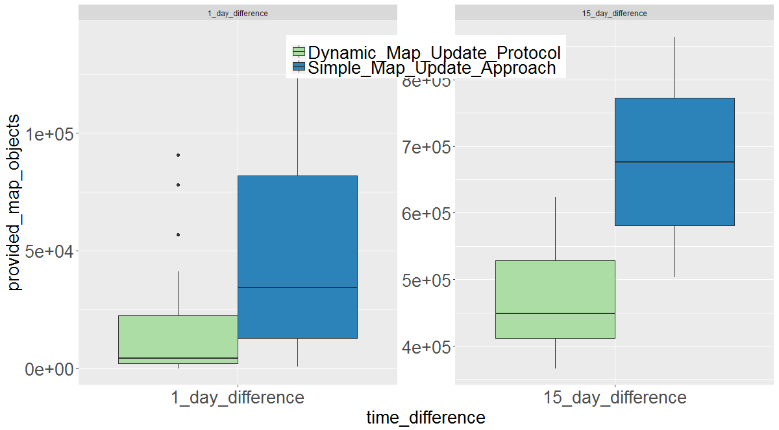
Evaluation Result
Scenario 2 (Client’s end)

Slide 31


Scenario 3: 100 trips for one autonomous car, 100 such cars
Calculates savings on client’s (car) end
https://upload.wikimedia.org/wikipedia/commons/0/01/Berlin_Stra%C3%9Fenverkehr_%C3%9Cbersichtskarte.png

Slide 32
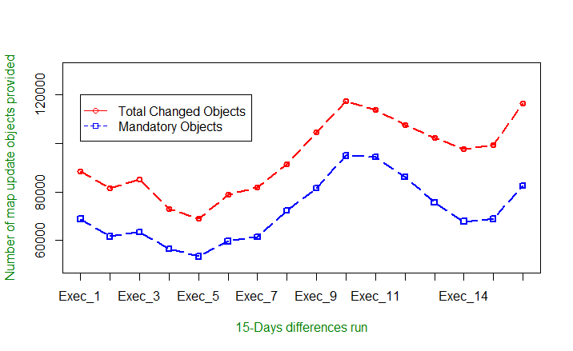
Variable amount of updates

Slide 33
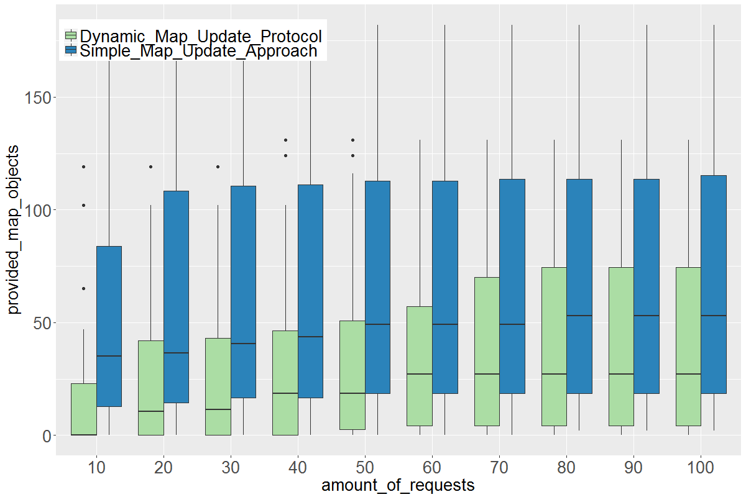
Map Object request pattern
Scenario 3 (1 Day Difference) (Client’s end)

Slide 34
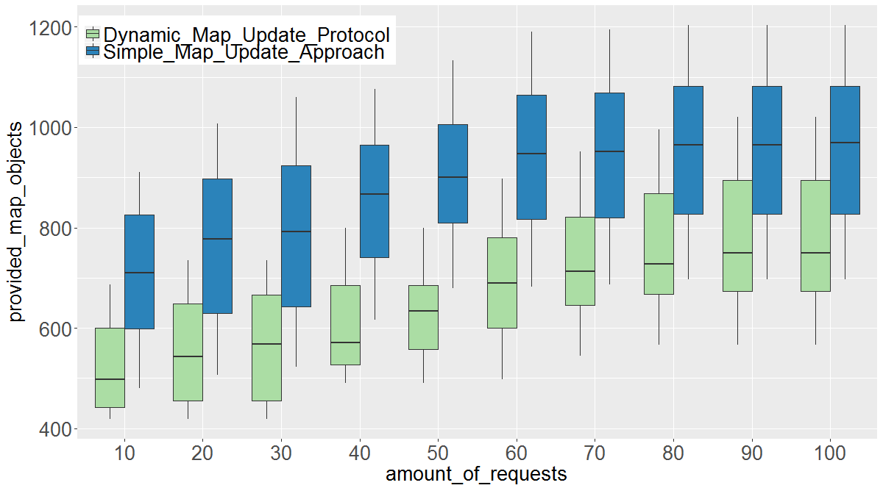
Map Object request pattern
Scenario 3 (15 Days Difference) (Client’s end)

Slide 35
Paired T-test
Number of requests | 10 | 20 | 30 | 40 | 50 | 60 | 70 | 80 | 90 | 100
1-day time difference | 1.90-06 | 1.46e-06 | 1.06e-06 | 2.69e-06 | 9.75e-07 | 5.40e-07 | 1.40e-06 | 1.42e-06 | 1.36e-06 | 1.40e-06
15-day time diffrence | 8.60e-09 | 3.96e-09 | 1.36e-09 | 7.14e-11 | 1.29e-12 | 1.69e-13 | 3.43e-11 | 2.12e-10 | 4.14e-10 | 8.03e-11

Slide 36
Evaluation (South Africa) in terms of Map Objects

Slide 37
Outline
Motivation
State of the art
The Approach
Results
Conclusion

Slide 38
Summary
High-definition maps are important
Frequent updates
Inefficiency in update processes
We can save data!
More research required

Slide 39
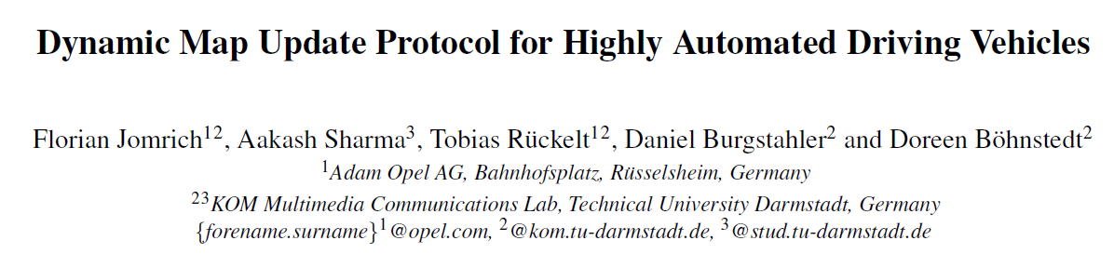
Future work arising from thesis
Publish a paper
Efficient delivery of map updates based on MoVeNet (Rueckelt et al.)
Ad-hoc Map Transfer between Vehicles using ProbSense.KOM (Burgstahler et al.)
Breadth-first Approach

Slide 40
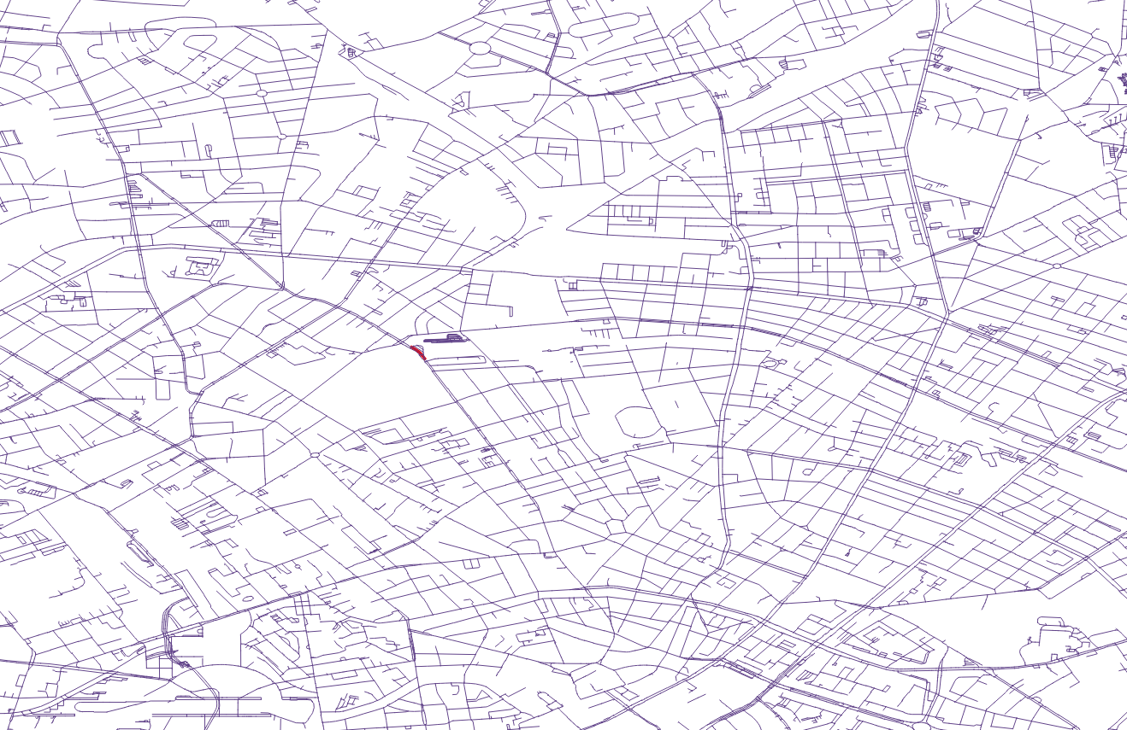
Breadth First Approach (Berlin)

Slide 41
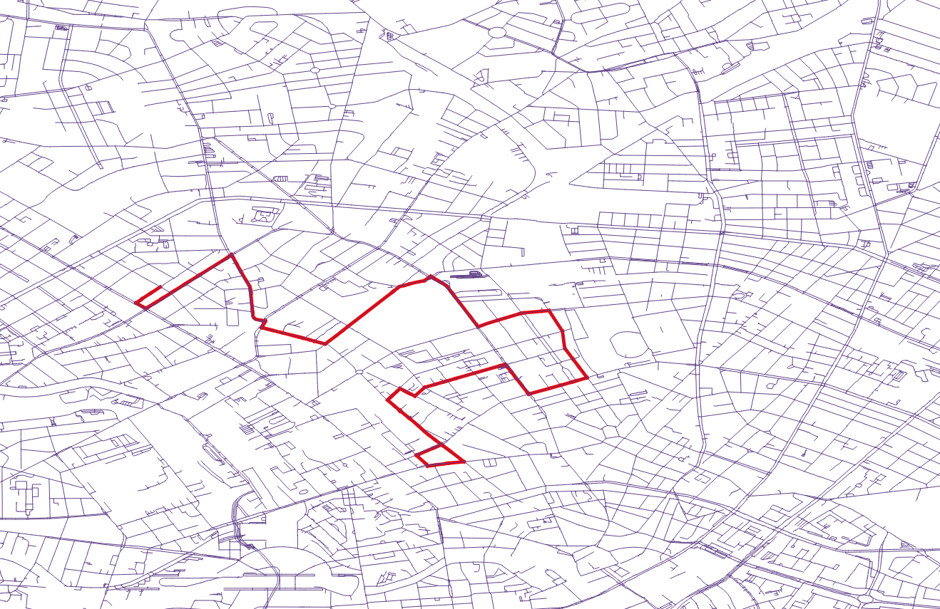
Breadth First Approach (Berlin)

Slide 42
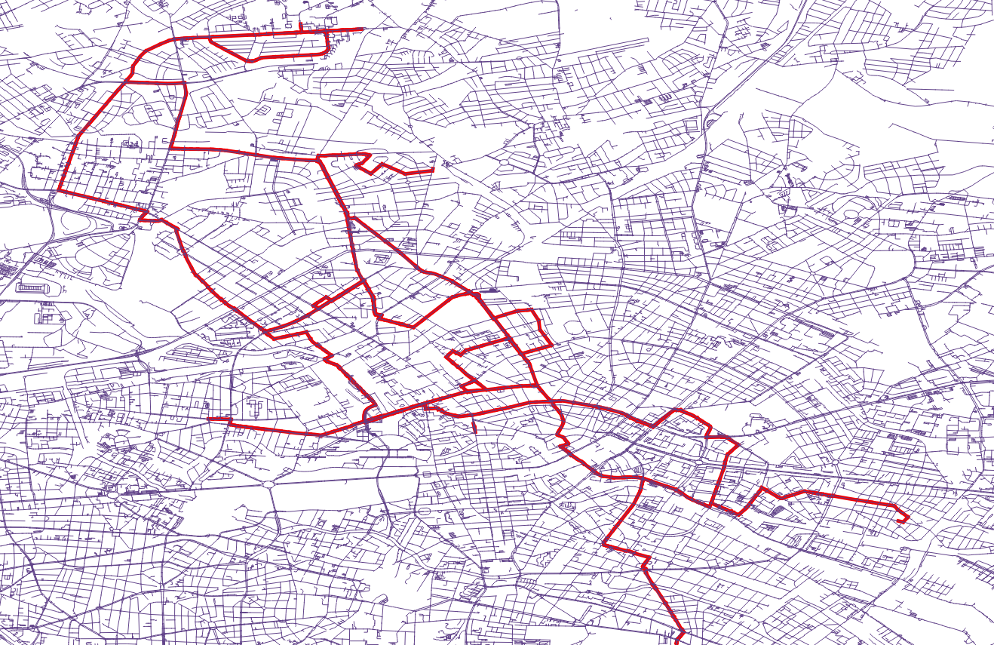
Breadth First Approach (Berlin)

Slide 43
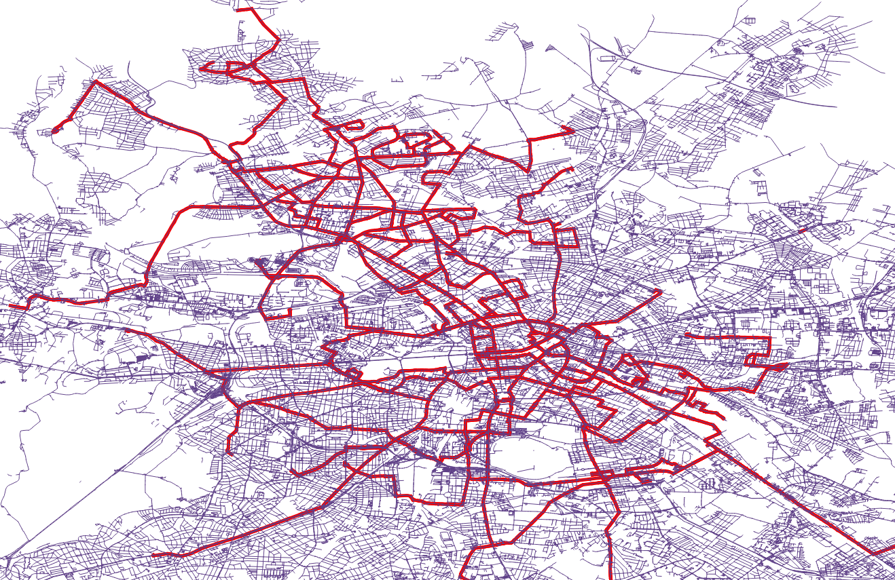
Breadth First Approach (Berlin)

Slide 44

Thank you for your attention! Questions?

Slide 45
Backup Slides

Slide 46


CAR
Server
1. Start, Destination, Map Tiles used by Car(ID, Version), Hash(Car Route)
2. Hash(Server Route), Map Tiles used by Server(ID, Version), Updates for Car Map Tiles
3. Car checks own version of Server Map Tiles
4. Request updates checked Map Tiles
5. Server generates necessary Map Updates
6. Further Updates for Car Map Tiles
7. Check if server hash = car hash now
1. Start, Destination, Map Tiles used by Car(ID, Version), Hash(Car Route)

Slide 47
Process flow with tools used
Berlin.osm.pbf downloaded from http://download.geofabrik.de/europe/germany/berlin.html
Osmosis https://wiki.openstreetmap.org/wiki/Osmosis
* Slightly modified version of osm2pgrouting, available at https://github.com/aakashysharma/osm2pgrouting or https://github.com/pgRouting/osm2pgrouting/tree/with-timestamp
# postgresql sever with extensions postgis & pgrouting
^ Python code with modules such as geohash, psycopg2, oset etc.

Slide 48
OpenStreet Map basics
<node id="298884272" lat="54.0901447" lon="12.2516513" user="SvenHRO" uid="46882" visible="true" version="1" changeset="676636" timestamp="2008-09-21T21:37:45Z"/>
<way id="26659127" user="Masch" uid="55988" visible="true" version="5" changeset="4142606" timestamp="2010-03-16T11:47:08Z">
<nd ref="292403538"/>
<nd ref="298884289"/>
...
<nd ref="261728686"/>
<tag k="highway" v="unclassified"/>
<tag k="name" v="Pastower Straße"/>
</way>
http://wiki.openstreetmap.org/wiki/OSM_XML

Slide 49
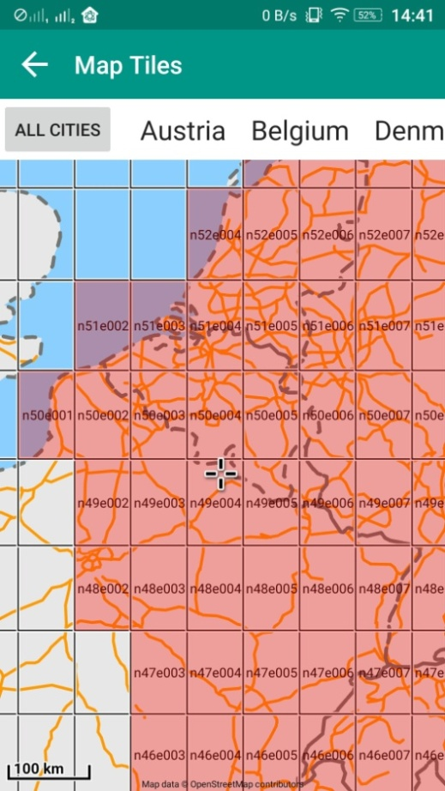
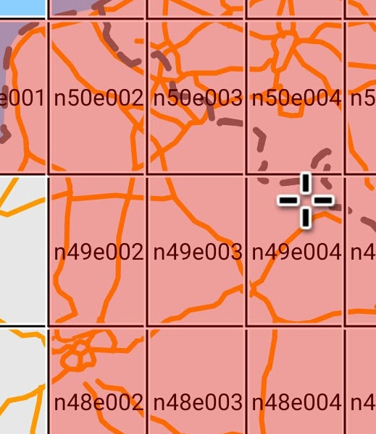
Grids
“Grid references define locations on maps using Cartesian coordinates.”
We are relying on latitude & longitude to mark a position and dividing the map into grids.
https://en.wikipedia.org/wiki/Grid_reference

Slide 50
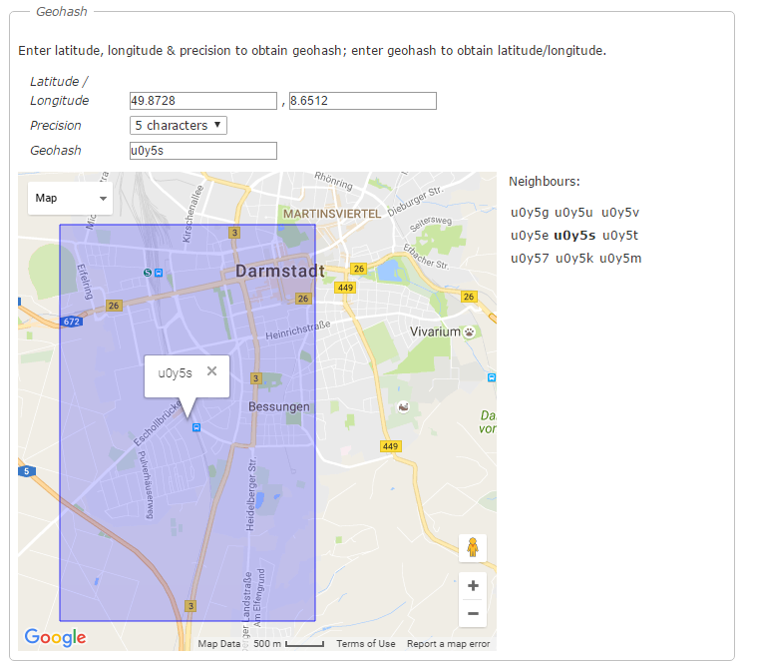
Geohash
Geohash is a latitude/longitude geocode system invented by Gustavo Niemeyer for encoding/decoding (lat,lon) pairs in a compact form.
Geohash is hierarchical
Nearby places will often
(but not always) present similar
prefixes
http://www.movable-type.co.uk/scripts/geohash.html

Slide 51
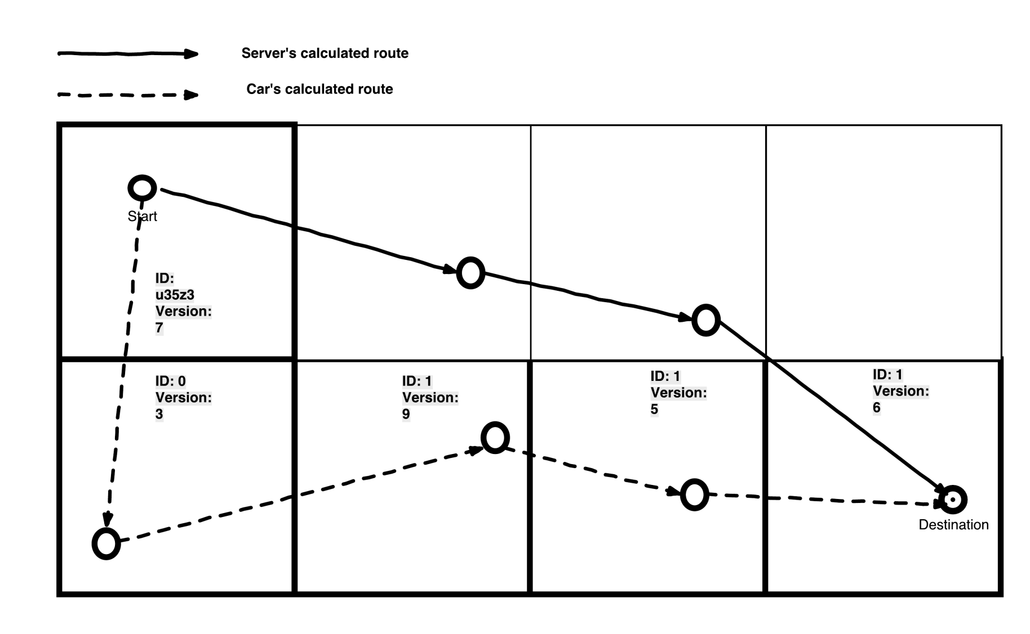

Slide 52
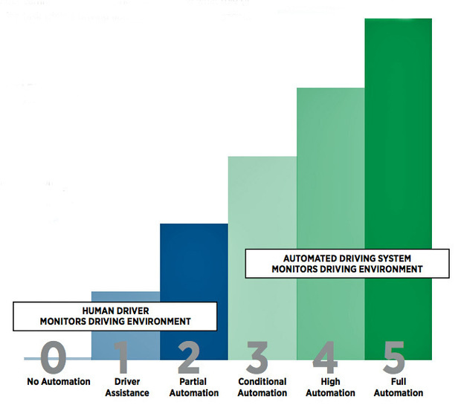
SAE’s Levels of Automation
http://core0.staticworld.net/images/article/2016/08/sae-levels-graphic-100677694-large.idge.jpg

Slide 53
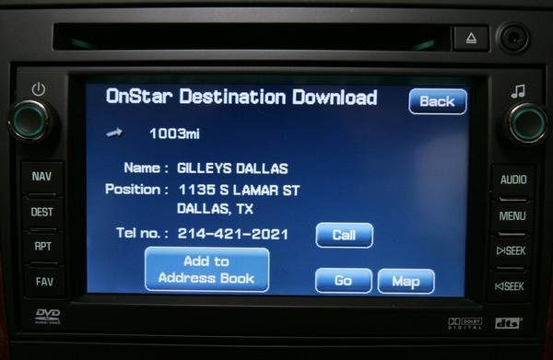
Hybrid Navigation Device / Connected Car
GM OnStar
BMW ConnectedDrive
http://pictures.topspeed.com/IMG/crop/200804/onstar-announces-des-1_600x0w.jpg
http://gmauthority.com/blog/wp-content/uploads/2011/06/How-OnStar-Works-small1.jpg

Slide 54
Another Update Example

Slide 55
Results
Difference | In Days | Total Mandatory Grids | Total Optional Grids | Total Grids with Changes | Saving by only updating Mandatory Grids | Savings % | Total Mandatory Updates | Total Optional Updates | Total Updates | Savings %
Scenario 1
2 Year | 973,00 | 49411 | 3959 | 53370 | 3959 | 7,42% | 105367504 | 2200467 | 107567971 | 2,05%
1 Year | 608,00 | 45715 | 6981 | 52696 | 6981 | 13,25% | 85379894 | 2755180 | 88135074 | 3,13%
45 Days | 46,00 | 20058 | 28708 | 48766 | 28708 | 58,87% | 11097508 | 2805121 | 13902629 | 20,18%
30 Days | 30,00 | 16402 | 31820 | 48222 | 31820 | 65,99% | 5100315 | 2428876 | 7529191 | 32,26%
15 Days | 15,00 | 11096 | 35032 | 46128 | 35032 | 75,95% | 2239539 | 1924499 | 4164038 | 46,22%
1 Day | 1,00 | 2822 | 21925 | 24747 | 21925 | 88,60% | 221784 | 682098 | 903882 | 75,46%

Slide 56
References
Wilson, Christopher KH, Seth Rogers, and Shawn Weisenburger. "The potential of precision maps in intelligent vehicles." IEEE International Conference on Intelligent Vehicles. 1998.
Balkić, Zoran, Damir Šoštarić, and Goran Horvat. "GeoHash and UUID identifier for multi-agent systems." KES International Symposium on Agent and Multi-Agent Systems: Technologies and Applications. Springer Berlin Heidelberg, 2012.
Ishikawa, Kunihiro, et al. "Map navigation software of the electro-multivision of the'91 Toyoto Soarer." Vehicle Navigation and Information Systems Conference, 1991. Vol. 2. IEEE, 1991.
Asahara, Akinori, et al. "Locally Differential Map Update Method with Maintained Road Connections for Telematics Services." Mobile Data Management Workshops, 2008. MDMW 2008. Ninth International Conference on. IEEE, 2008.
Bastiaensen, Edwin. "ActMAP: real-time map updates for advanced in-vehicle applications." Proceedings, 10th World Congress on ITS, Madrid. 2003.
Notes:
November 19, 2007
|
| 56

Slide 57
References
Min, Kyoungwook, et al. "A system framework for map air update navigation service." ETRI Journal 33.4 (2011): 476-486.
Min, Kyoung-Wook, et al. "The mobile spatial DBMS for the partial map air update in the navigation." 2008 11th International IEEE Conference on Intelligent Transportation Systems. IEEE, 2008.
Kopf, Johannes, et al. "Automatic generation of destination maps." ACM Transactions on Graphics (TOG). Vol. 29. No. 6. ACM, 2010.
Balley, S., and N. Regnauld. "Models and standards for on-demand mapping." Proceedings of the 25th international cartographic conference. Paris. 2011.
Schindler, Andreas. "Vehicle self-localization with high-precision digital maps." Intelligent Vehicles Symposium (IV), 2013 IEEE. IEEE, 2013.
Notes:
November 19, 2007
|
| 57

Slide 58
References
Mikuriya, Makoto, et al. "Data structure of map data, map data storage medium, map data updating method and map data processing apparatus." U.S. Patent No. 7,526,492. 28 Apr. 2009.
Fischer, Sebastian, and Holger Dormann. "Technique for structuring a navigation database." U.S. Patent No. 9,280,567. 8 Mar. 2016.
Kamijo, Shunichiro, Koze Okumura, and Akinao Kitamura. "Digital road map database for vehicle navigation and road information systems." Vehicle Navigation and Information Systems Conference, 1989. Conference Record. IEEE, 1989.
Rueckelt, Tobias, et al. "MoVeNet: Mobility Management for Vehicular Networking." Proceedings of the 14th ACM International Symposium on Mobility Management and Wireless Access. ACM, 2016.
Burgstahler, Daniel, et al. "ProbSense. KOM: A Probabilistic Sensing Approach for Gathering Vehicular Sensed Data." Mobile Services (MS), 2016 IEEE International Conference on. IEEE, 2016.
Notes:
November 19, 2007
|
| 58

